Slide 1


Centre For Development Of Advanced Computing, Bangalore
Sagar Deware (WBL240301013)
Ms. Priyanka Sethi (Project Guide)
31 May 2024
31-05-2024

Slide 2
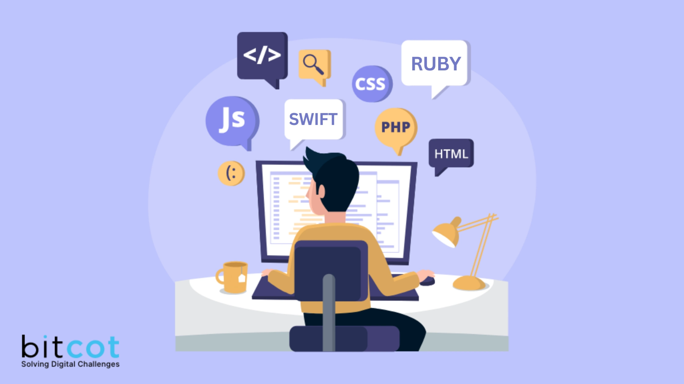

Roles And Responsibilities
As Web developer intern, my primary responsibilities for the project are creating Web pages for ongoing project which includes frontend, backend and database. Additionally Creating Documentation for the project
Secondary duty was to assisting pg diploma students in their course like JAVA,Database,DSA
05-03-2023

Slide 3


Project Description
Project provides users, including employees and students, with an intuitive platform to effortlessly customize and send bulk emails using pre-designed templates, saving time and resources.
By eliminating common manual mailing challenges like errors and delays, the system ensures swift and accurate communication, aligning with modern productivity standards.

Slide 4


Internship Activities
As the Starting of Internship, Initial task was to Research and find the best possible solution for the given Project. With the given TechStack for the project.
The SEBoK provides a compendium of the key knowledge sources and references of systems engineering organized and explained to assist a wide variety of users

Slide 5

Internship Activities
After finding the solution for the project, Creating Documentation for project was done which is considered to be crucial step in SDLC. The SRS, FRS and DD are the documents which were created for the project.
SRS is a complete specification and description of requirements of the software that need to be fulfilled for the successful development of the software system.
FRS, describes the functional requirements of a product.contains the functional requirements of the product being developed.
DD, provides a description of a software product in terms of architecture of software with various components with specified functionality.

Slide 6
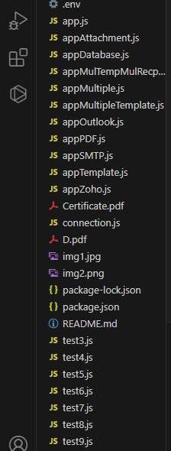
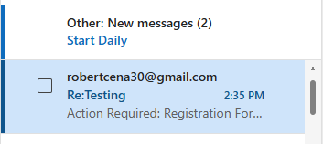
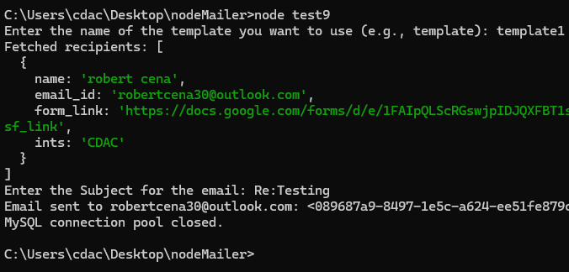
Internship Activities
For the Development part, It was important to implement the basic functionality of the project. Trying Different Scenario,format , operator additionally testing different combination of template and attachment.
As as core functionality, the testing was done through Console.

Slide 7
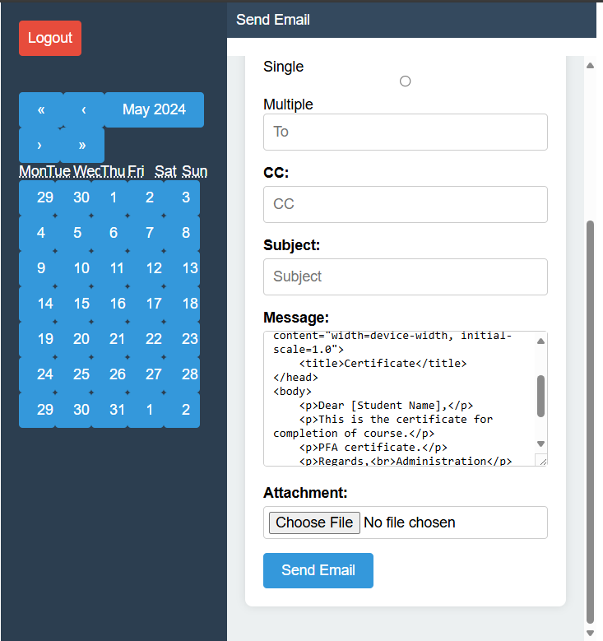
Internship Activities
After Implementing the Basic Functionality, it was time to implement web application as root software.Using NodeJS and Express Framework for Backend , ReactJS for frontend, MySql as Database the web Application was creating. Initially it is to implement the basic mail sending system.
Draft GUI

Slide 8

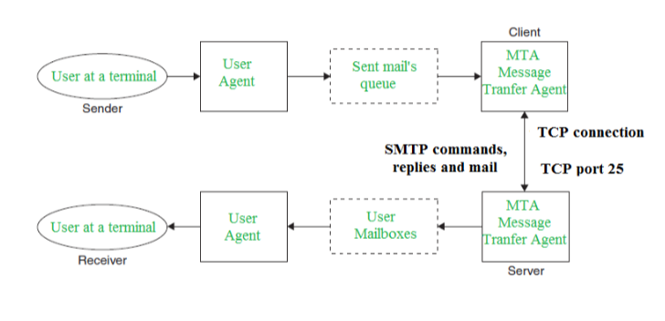


TechStack And Library
The Simple Mail Transfer Protocol (SMTP) is an application used by mail servers to send, receive, and relay outgoing email between senders and receivers.
Nodemailer is a module for Node.js applications to allow easy as cake email sending.

Slide 9
REFERENCES
SMTP (Simple Mail Transfer Protocol): Servers and Sending Emails | SendGrid
Nodemailer :: Nodemailer
MySQL
React

Slide 10
THANK YOU

